Slide 1


Comprehensive Retail Sales Analysis
Kiran Bakare
Date :- 10/07/2024

Slide 2

Problem Statement: You are working as a data analyst for a retail company. Your goal is to analyze sales data to provide insights into the performance of different regions, products, and customer segments using SQL. This project aims to extract and manipulate data to uncover valuable insights and trends.

Slide 3

Overview: This presentation examines the sales performance of a retail company through detailed SQL analysis. We explore key metrics, customer insights, and profitability across different product categories and regions. Key Objectives: Analyze total sales, profit margins, and average order values by region. Identify top-performing products based on sales and profit. Understand customer behavior and segmentation through SQL-derived insights.

Slide 4

1.Sales Analysis

Slide 5
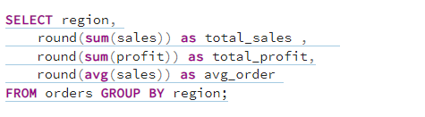
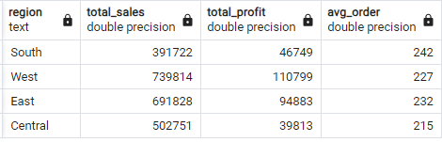
What are the total sales, total profit, and average order value by region?

Slide 6
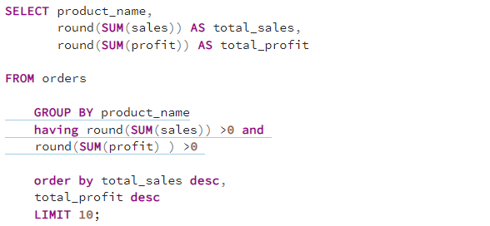
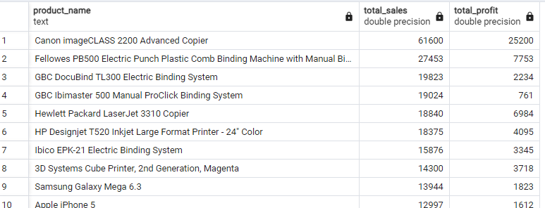
Who are the top 10 products by total sales and profit?

Slide 7
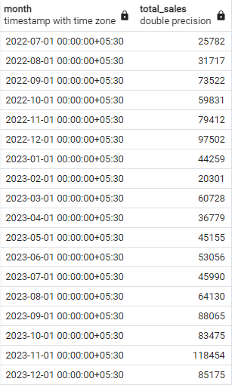
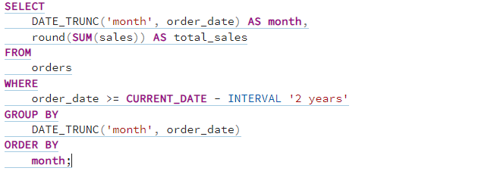
What are the monthly sales trends over the past two years?

Slide 8
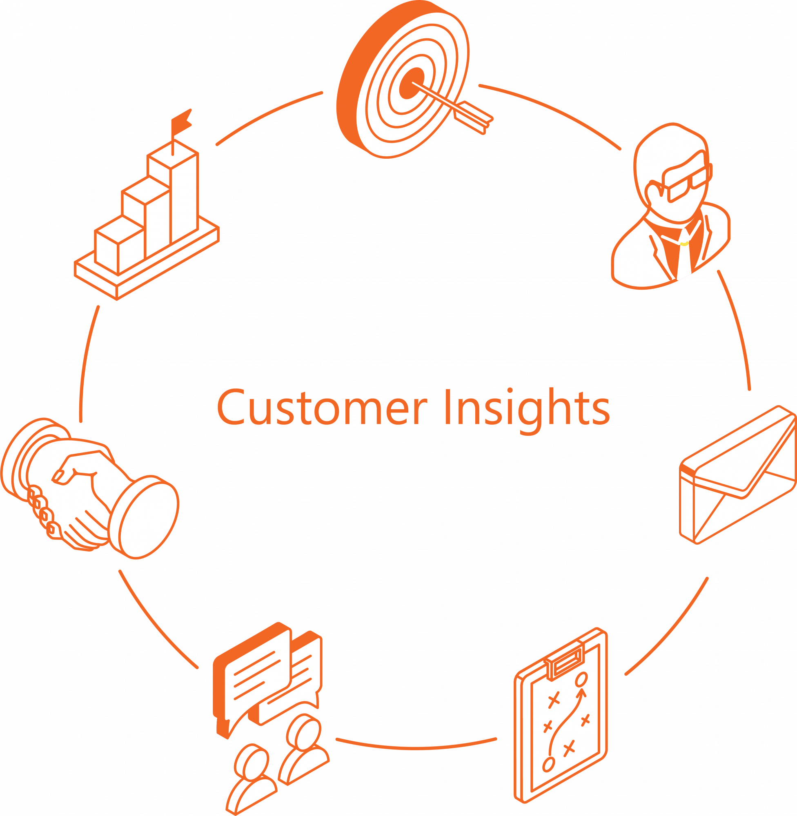
2.Customer Insights

Slide 9
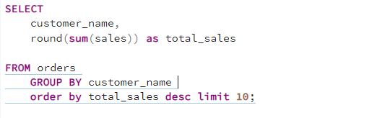
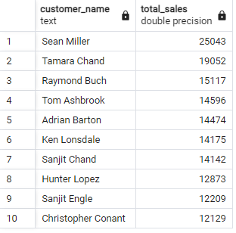
Who are the top 10 customers based on total sales?

Slide 10
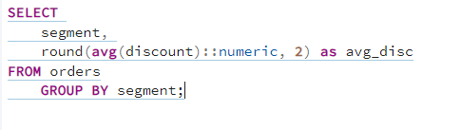
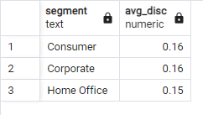
What is the average discount given to each customer segment?

Slide 11
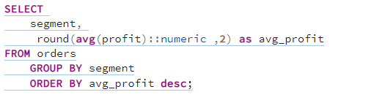
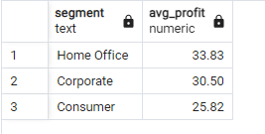
Which customer segments have the highest average profit per order?

Slide 12

3.Order Details

Slide 13
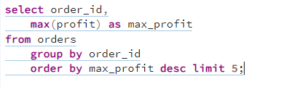
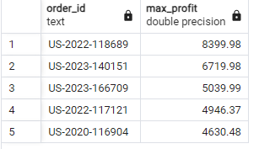
Which orders have the highest profit margins?

Slide 14
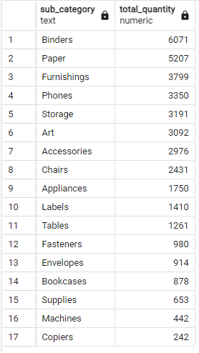
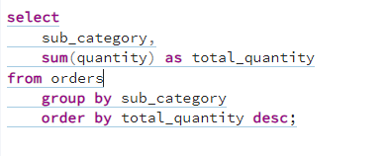
What is the total quantity sold for each product sub-category, and what trends can be identified?

Slide 15
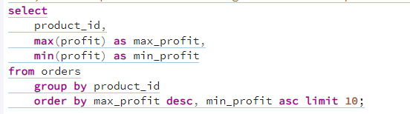
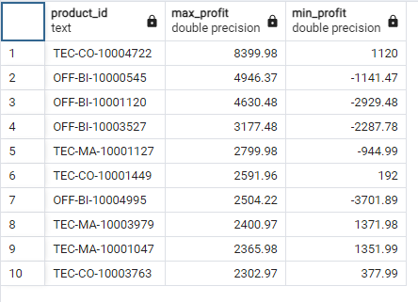
Which products have the highest and lowest profit margins?

Slide 16
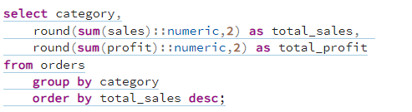
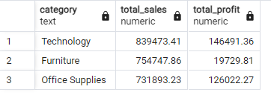
What are the total sales and total profit for each product category?

Slide 17
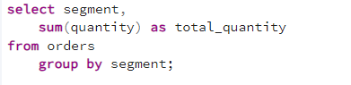
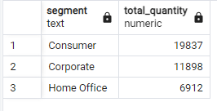
How does the quantity sold vary across different customer segments?

Slide 18

4.Profit Analysis

Slide 19
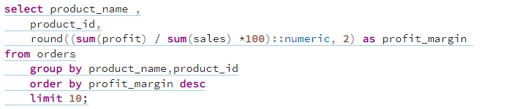
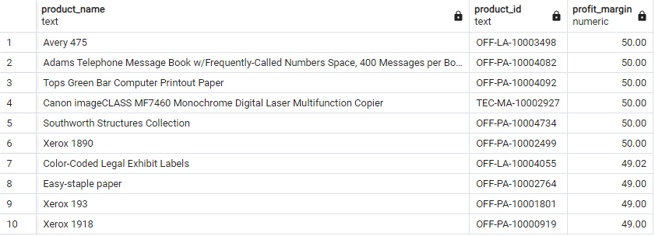
What is the profit margin for each product?

Slide 20
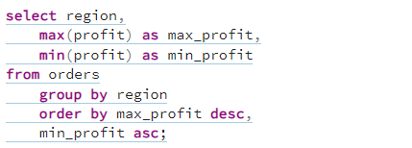
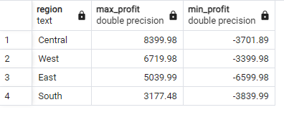
Which regions have the highest and lowest profit margins?

Slide 21
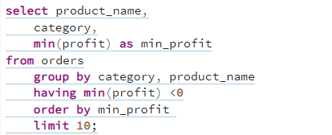
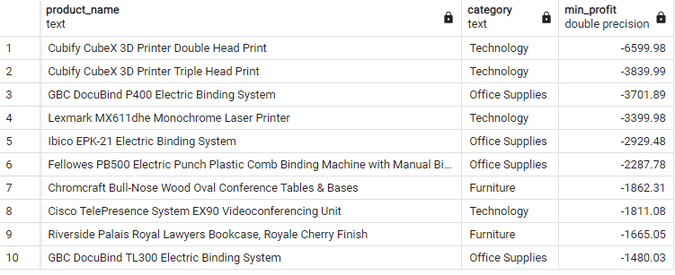
Which products and categories have negative profit margins, and what might be the reasons?

Slide 22

LinkedIn : LinkedIn Profile
Twitter : Twitter Profile
Github : Github Profile

